Slide 1
Dynamical Systems in Neuroscience
Saeed Taghavi

Slide 2
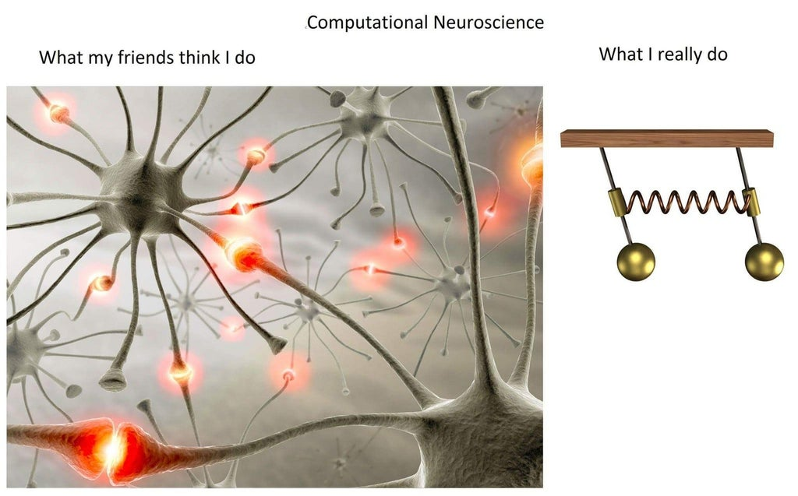
Computational Neuroscience

Slide 3
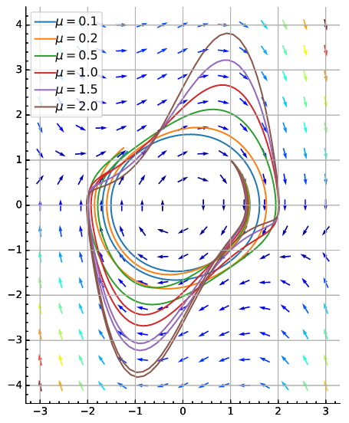
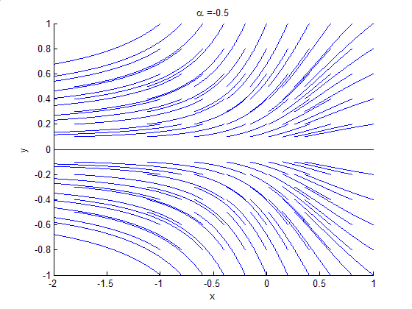
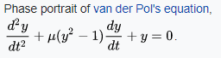
Dynamical Systems
Introduction
The Morris-Lecar Model
Fitzhugh-Nagumo model
The Phase Plane
nullclines – flow
Equilibrium
Stability
Types of Equilibria
Bifurcation Analysis
Phase portrait showing saddle-node bifurcation

Slide 4
Introduction to Dynamical Systems
Dynamical systems theory provides a powerful tool for analyzing nonlinear systems of differential equations, including those that arise in neuroscience. This theory allows us to interpret solutions geometrically as curves in a phase space. By studying the geometric structure of phase space, we are often able to classify the types of solutions that a model may exhibit and determine how solutions depend on the model’s parameters. For example, we can often predict if a model neuron will generate an action potential, determine for which values of the parameters the model will produce oscillations, and compute how the frequency of oscillations depends on the parameters.
In this chapter, we introduce many of the basic concepts of dynamical systems theory using a reduced two-variable model: the Morris–Lecar equations.

Slide 5
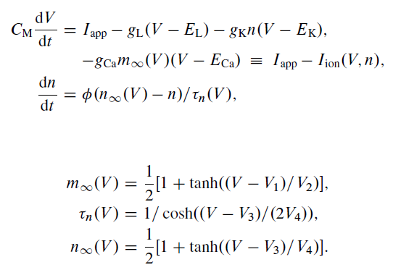
The Morris–Lecar Model
The model has three channels: a potassium channel, a leak, and a calcium channel.
the calcium current depends instantaneously on the voltage.

Slide 6
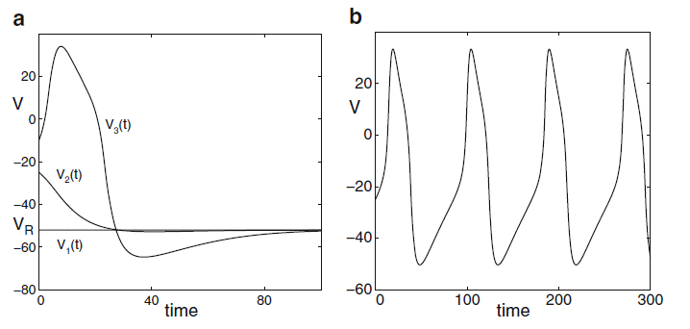
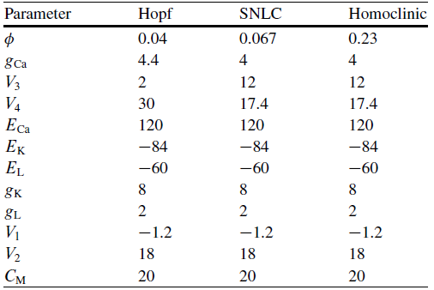
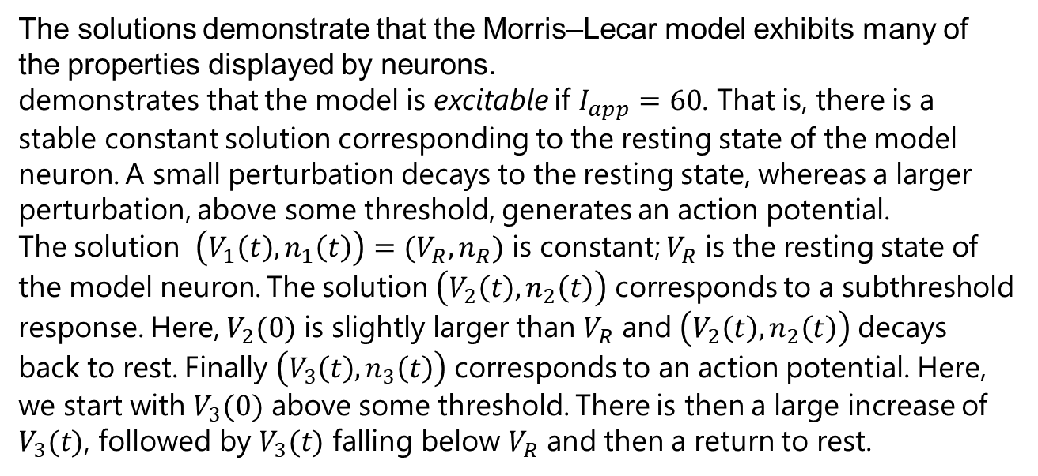
The Morris–Lecar Model
The solutions demonstrate that the Morris–Lecar model exhibits many of the properties displayed by neurons.
demonstrates that the model is excitable if $I_{app}=60$. That is, there is a stable constant solution corresponding to the resting state of the model neuron. A small perturbation decays to the resting state, whereas a larger perturbation, above some threshold, generates an action potential.
The solution $\left(V_{1}\left(t\right),n_{1}\left(t\right)\right)=(V_{R},n_{R})$ is constant; $V_{R}$ is the resting state of the model neuron. The solution $\left(V_{2}\left(t\right),n_{2}\left(t\right)\right)$ corresponds to a subthreshold response. Here, $V_{2}(0)$ is slightly larger than $V_{R}$ and $\left(V_{2}\left(t\right),n_{2}\left(t\right)\right)$ decays back to rest. Finally $\left(V_{3}\left(t\right),n_{3}\left(t\right)\right)$ corresponds to an action potential. Here, we start with $V_{3}(0)$ above some threshold. There is then a large increase of $V_{3}(t)$, followed by $V_{3}(t)$ falling below $V_{R}$ and then a return to rest.

Slide 7
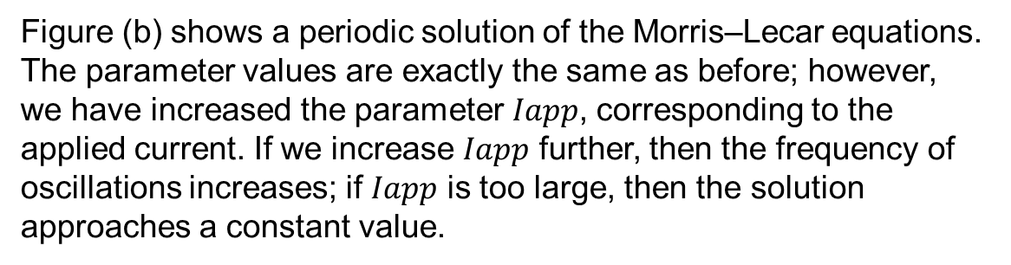
The Morris–Lecar Model
Figure (b) shows a periodic solution of the Morris–Lecar equations. The parameter values are exactly the same as before; however, we have increased the parameter $Iapp$, corresponding to the applied current. If we increase $Iapp$ further, then the frequency of oscillations increases; if $Iapp$ is too large, then the solution approaches a constant value.
In the following, we will show how dynamical systems methods can be used to mathematically analyze these solutions. The analysis is extremely useful in understanding when this type of model, for a given set of parameters, displays a particular type of behavior. The behavior may change as parameters are varied; an important goal of bifurcation theory, which we describe later, is to determine when and what types of transitions take place.

Slide 8
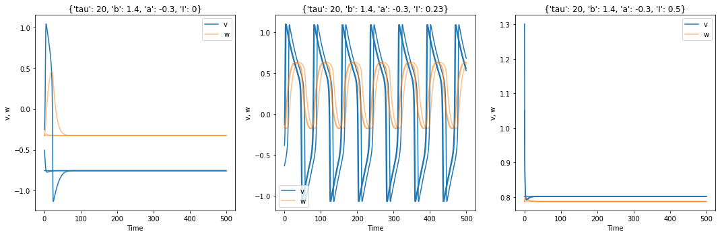
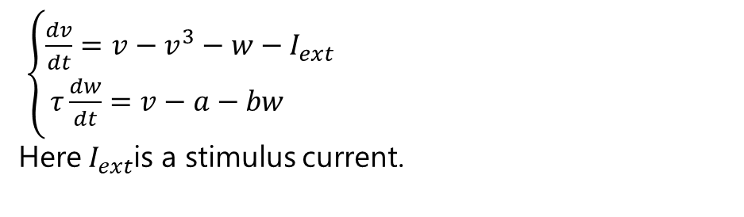
Fitzhugh-Nagumo model
The Fitzhugh-Nagumo model of an excitable system is a two-dimensional simplification of the Hodgkin-Huxley model of spike generation in squid giant axons.
$\left\{\begin{aligned}\frac{dv}{dt}=v−v^{3}−w−I_{ext} \\ τ\frac{dw}{dt}=v−a−bw \end{aligned}\right.$
Here $I_{ext}$is a stimulus current.

Slide 9
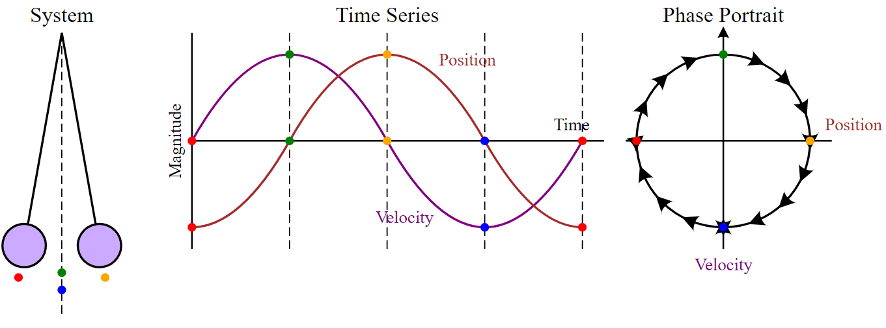
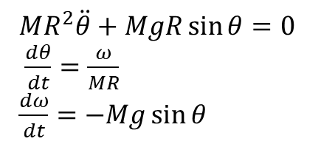
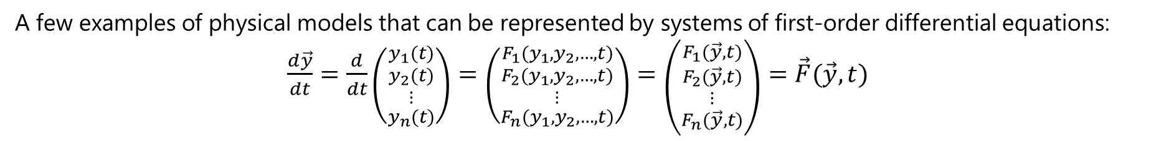
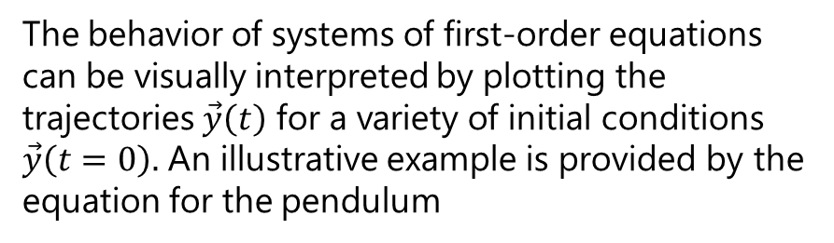
ODEs
A few examples of physical models that can be represented by systems of first-order differential equations:
$\frac{d\vec{y}}{dt}=\frac{d}{dt}\left({y_{1}(t) \atop \begin{aligned}y_{2}(t) \\ ⋮ \\ y_{n}(t)\end{aligned}}\right)=\left({F_{1}(y_{1},y_{2}, …,t) \atop \begin{aligned}F_{2}(y_{1},y_{2}, …,t) \\ ⋮ \\ F_{n}(y_{1},y_{2}, …,t)\end{aligned}}\right)=\left({F_{1}(\vec{y}, t) \atop \begin{aligned}F_{2}(\vec{y}, t) \\ ⋮ \\ F_{n}(\vec{y}, t)\end{aligned}}\right)=\vec{F}(\vec{y}, t)$
and, furthermore, it has been shown that many higher-order systems of ODEs can be reduced to larger systems of first-order ODEs.
The behavior of systems of first-order equations can be visually interpreted by plotting the trajectories $\vec{y}\left(t\right)$ for a variety of initial conditions $\vec{y}\left(t=0\right).$ An illustrative example is provided by the equation for the pendulum
how a phase portrait would be constructed for the motion of a simple pendulum.
$MR^{2}\ddot{θ}+MgR\sin{θ}=0$
$\frac{dθ}{dt}=\frac{ω}{MR}$
$\frac{dω}{dt}=−Mg\sin{θ}$

Slide 10
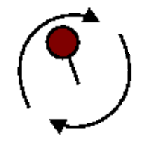
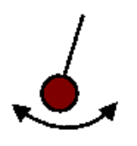
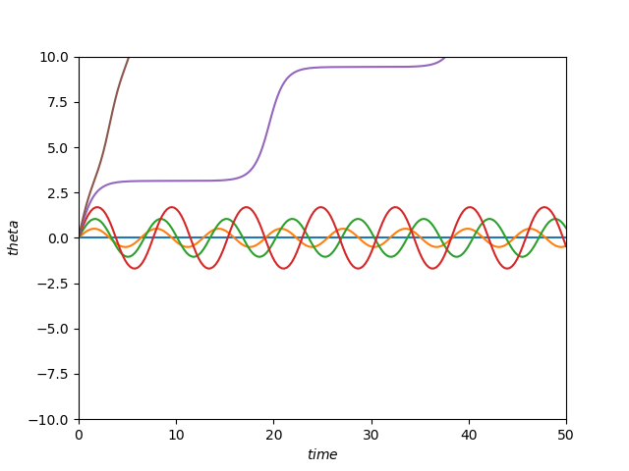
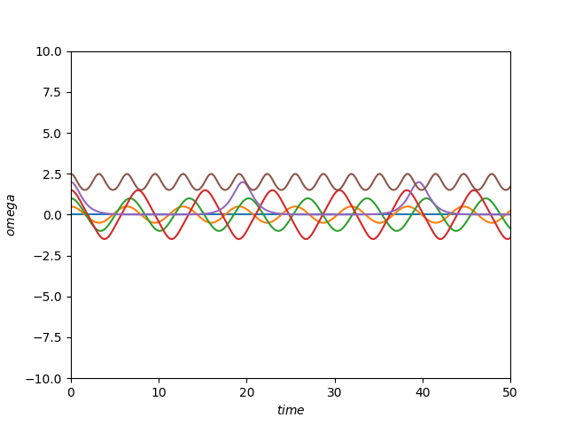
Trajectories – Time series

Slide 11
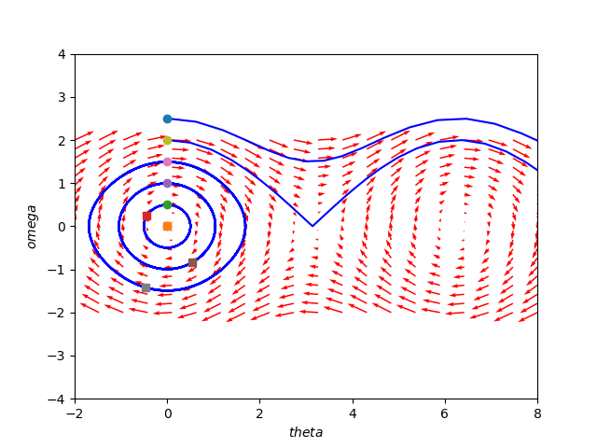
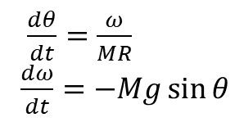
The Phase Plane
a phase plane is a visual display of certain characteristics of certain kinds of differential equations.
The phase plane method refers to graphically determining the existence of limit cycles in the solutions of the differential equation.
The solutions to the differential equation are a family of functions. Graphically, this can be plotted in the phase plane like a two-dimensional vector field. Vectors representing the derivatives of the points, e.g. (dx/dt, dy/dt), at representative points are drawn. With enough of these arrows in place the system behavior over the regions of plane in analysis can be visualized and limit cycles can be easily identified.
$\frac{dθ}{dt}=\frac{ω}{MR}$
$\frac{dω}{dt}=−Mg\sin{θ}$

Slide 12
Phase Portrait
The entire field is the phase portrait, a particular path taken along a flow line (i.e. a path always tangent to the vectors) is a phase path.
how a phase portrait would be constructed for the motion of a simple pendulum.

Slide 13
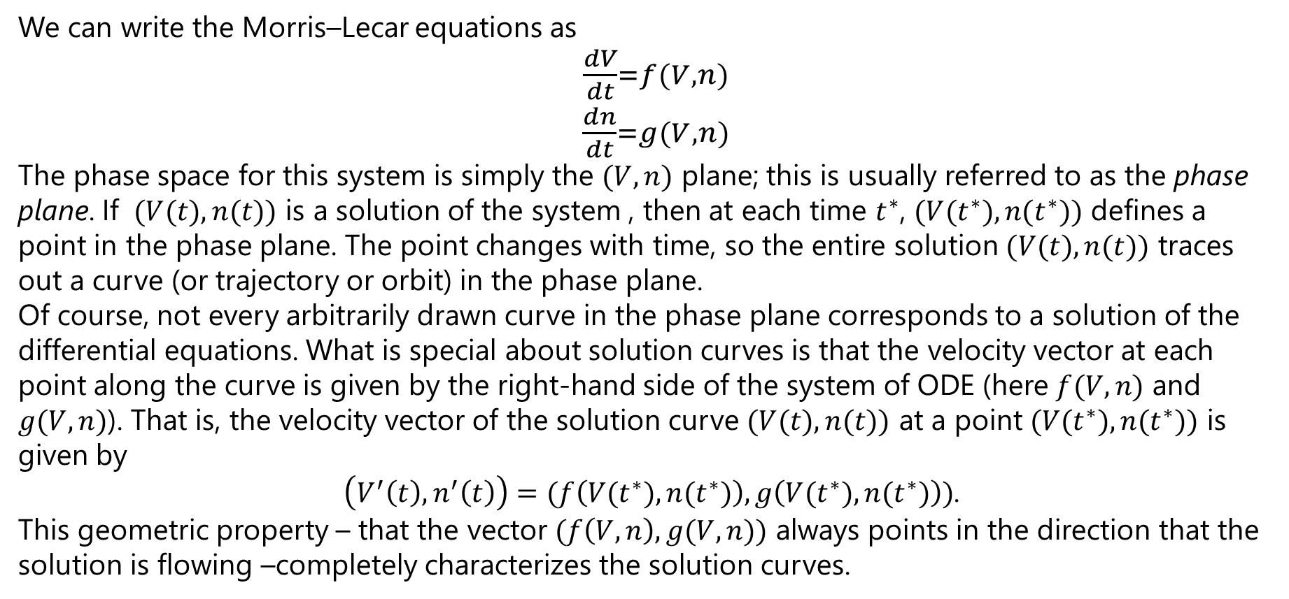
The Phase Plane
We can write the Morris–Lecar equations as
${\frac{dV}{dt}=f(V,n) \atop \frac{dn}{dt}=g(V,n)}$
The phase space for this system is simply the $(V,n)$ plane; this is usually referred to as the phase plane. If $(V(t),n(t))$ is a solution of the system , then at each time $t^{∗}$, $(V(t^{∗}),n(t^{∗}))$ defines a point in the phase plane. The point changes with time, so the entire solution $(V(t),n(t))$ traces out a curve (or trajectory or orbit) in the phase plane.
Of course, not every arbitrarily drawn curve in the phase plane corresponds to a solution of the differential equations. What is special about solution curves is that the velocity vector at each point along the curve is given by the right-hand side of the system of ODE (here $f(V,n)$ and $g(V,n)$). That is, the velocity vector of the solution curve $(V(t),n(t))$ at a point $(V(t^{∗}),n(t^{∗}))$ is given by
$\left(V^{′}\left(t\right),n^{′}\left(t\right)\right)=(f\left(V(t^{∗}),n(t^{∗})\right),g\left(V(t^{∗}),n(t^{∗})\right))$.
This geometric property – that the vector $(f\left(V,n\right),g(V,n))$ always points in the direction that the solution is flowing –completely characterizes the solution curves.

Slide 14
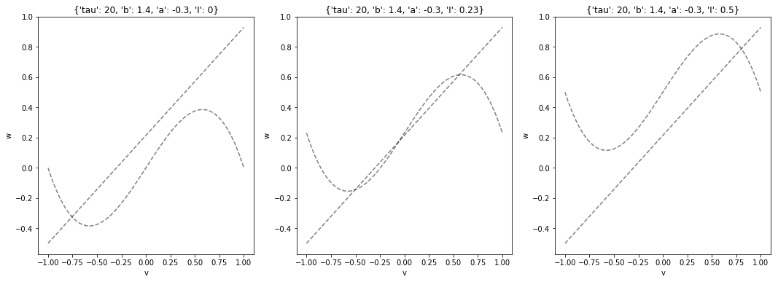
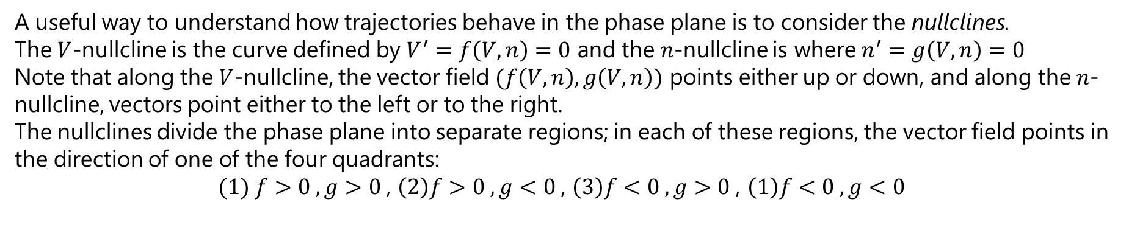
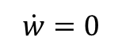
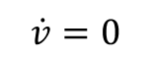
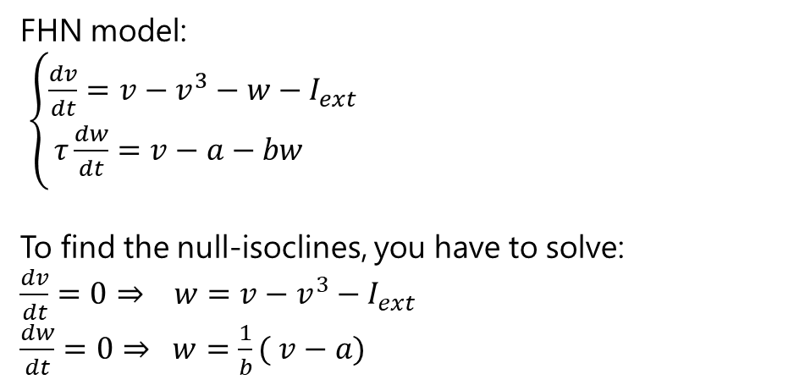
The Phase Plane – Nullclines (Isoclines zero)
A useful way to understand how trajectories behave in the phase plane is to consider the nullclines.
The $V$-nullcline is the curve defined by $V^{′}=f\left(V,n\right)=0$ and the $n$-nullcline is where $n^{′}=g\left(V,n\right)=0$
Note that along the $V$-nullcline, the vector field $(f\left(V,n\right),g\left(V,n\right))$ points either up or down, and along the $n$-nullcline, vectors point either to the left or to the right.
The nullclines divide the phase plane into separate regions; in each of these regions, the vector field points in the direction of one of the four quadrants:
$(1) f>0 , g>0$, $\left(2\right)f>0 , g<0$, $\left(3\right)f<0 , g>0$, $\left(1\right)f<0 , g<0$
FHN model:
$\left\{\begin{aligned}\frac{dv}{dt}=v−v^{3}−w−I_{ext} \\ τ\frac{dw}{dt}=v−a−bw \end{aligned}\right.$
To find the null-isoclines, you have to solve: $\frac{dv}{dt}=0⇒ w=v−v^{3}−I_{ext}$
$\frac{dw}{dt}=0⇒ w=\frac{1}{b}( v−a)$
$$\dot{w}=0$$
$$\dot{v}=0$$

Slide 15
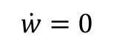
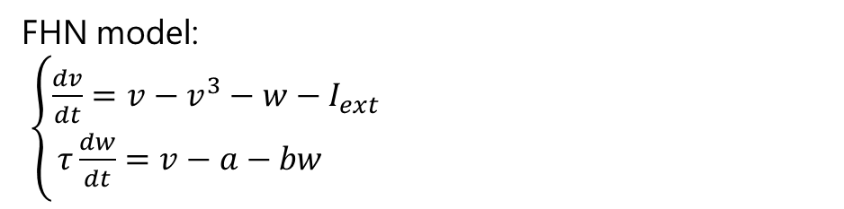
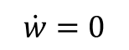
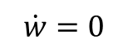
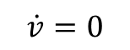
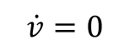
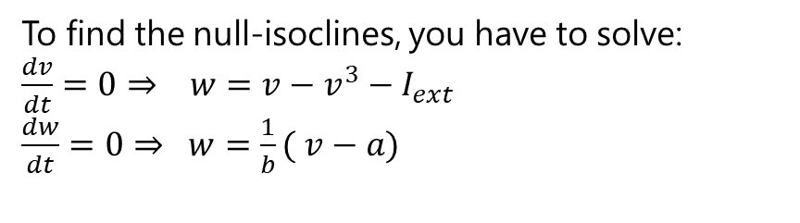
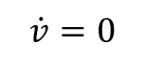
The Phase Plane – Nullclines (Isoclines zero)
FHN model:
$\left\{\begin{aligned}\frac{dv}{dt}=v−v^{3}−w−I_{ext} \\ τ\frac{dw}{dt}=v−a−bw \end{aligned}\right.$
To find the null-isoclines, you have to solve: $\frac{dv}{dt}=0⇒ w=v−v^{3}−I_{ext}$
$\frac{dw}{dt}=0⇒ w=\frac{1}{b}( v−a)$
$$\dot{w}=0$$
$$\dot{w}=0$$
$$\dot{v}=0$$
$$\dot{v}=0$$
$$\dot{v}=0$$
$$\dot{w}=0$$

Slide 16
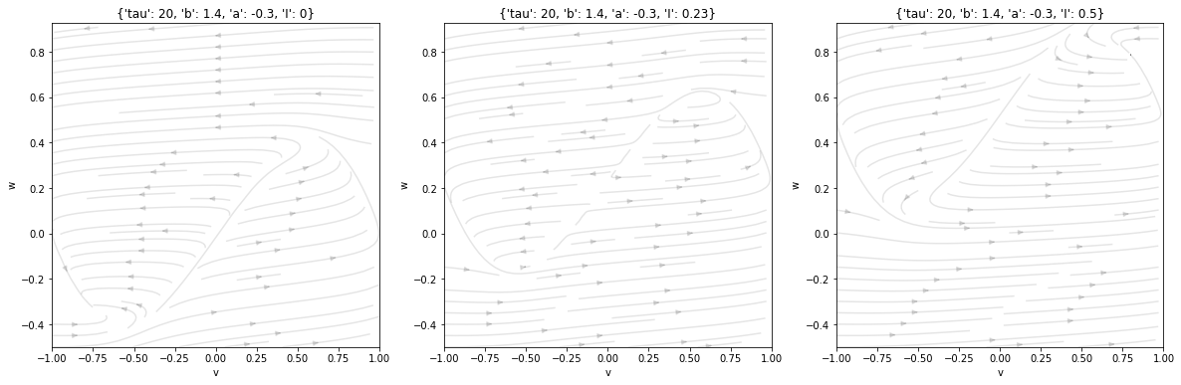
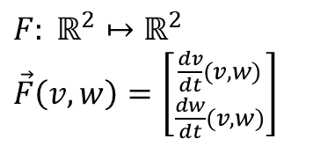
The Phase Plane – Flow
Let us plot the flow, which is the vector field defined by:
$F: ℝ^{2}↦ℝ^{2}$
$\vec{F}\left(v,w\right)=\left[{\frac{dv}{dt}(v,w) \atop \frac{dw}{dt}(v,w)}\right]$

Slide 17
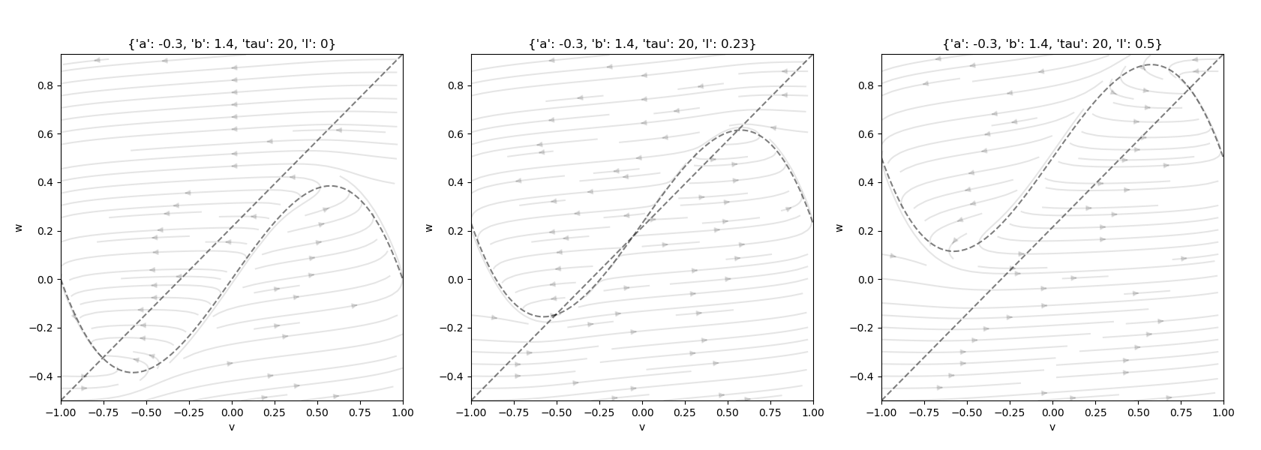

The Phase Plane – Flow
Let us plot the flow, which is the vector field defined by:
$F: ℝ^{2}↦ℝ^{2}$
$\vec{F}\left(v,w\right)=\left[{\frac{dv}{dt}(v,w) \atop \frac{dw}{dt}(v,w)}\right]$

Slide 18
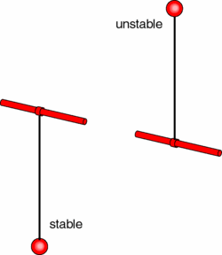
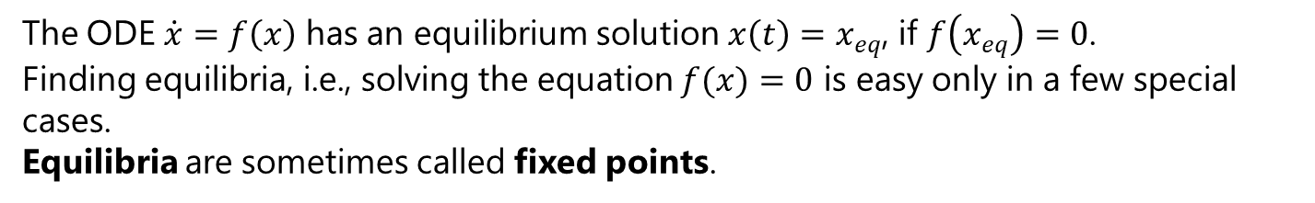
The Phase Plane – Equilibrium points (Critical points)
An equilibrium point of a dynamical system generated by an autonomous system of ODEs is a solution that does not change with time. For example, each motionless pendulum position in Figure corresponds to an equilibrium of the corresponding equations of motion, one is stable, the other one is not.
Geometrically, equilibria are points in the system's phase space.
The ODE $\dot{x}=f\left(x\right)$ has an equilibrium solution $x\left(t\right)=x_{eq}$, if $f\left(x_{eq}\right)=0$.
Finding equilibria, i.e., solving the equation $f(x)=0$ is easy only in a few special cases.
Equilibria are sometimes called fixed points.

Slide 19
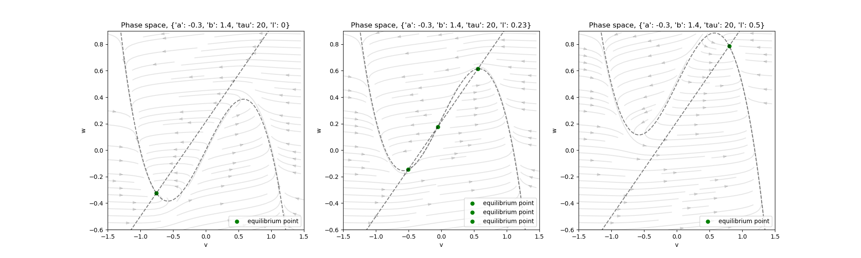
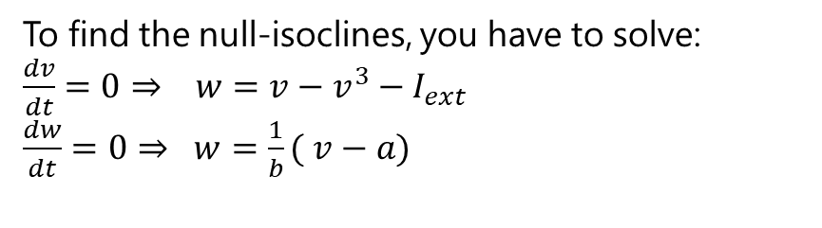
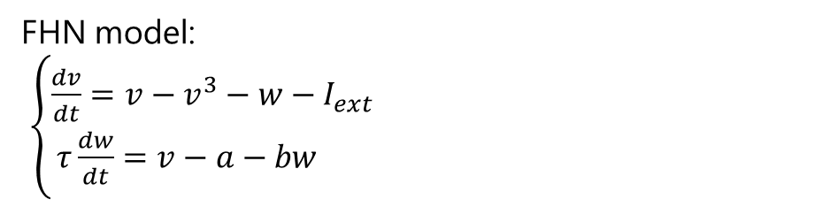
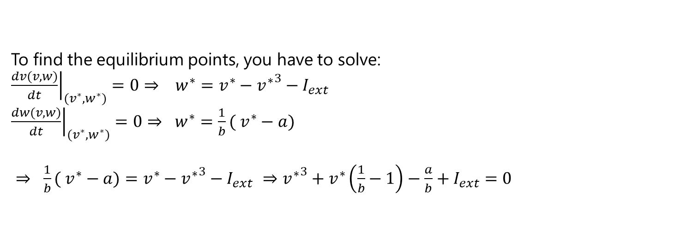
The Phase Plane – Equilibrium points (Critical points)
The equilibria are found at the crossing between the nullclines.
FHN model:
$\left\{\begin{aligned}\frac{dv}{dt}=v−v^{3}−w−I_{ext} \\ τ\frac{dw}{dt}=v−a−bw \end{aligned}\right.$
To find the null-isoclines, you have to solve: $\frac{dv}{dt}=0⇒ w=v−v^{3}−I_{ext}$
$\frac{dw}{dt}=0⇒ w=\frac{1}{b}( v−a)$
To find the equilibrium points, you have to solve: ${\left.\frac{dv(v,w)}{dt}\right|}_{{(v}^{∗},w^{∗})}=0⇒ w^{∗}=v^{∗}−{v^{∗}}^{3}−I_{ext}$
${\left.\frac{dw(v,w)}{dt}\right|}_{{(v}^{∗},w^{∗})}=0⇒ w^{∗}=\frac{1}{b}( v^{∗}−a)$
$⇒ \frac{1}{b}( v^{∗}−a)=v^{∗}−{v^{∗}}^{3}−I_{ext}$ $⇒{v^{∗}}^{3}+v^{∗}\left(\frac{1}{b}−1\right)−\frac{a}{b}+I_{ext}=0$
Find the roots of this equation

Slide 20
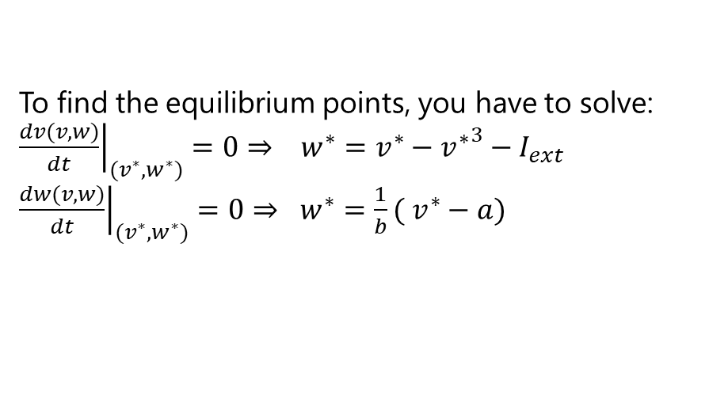
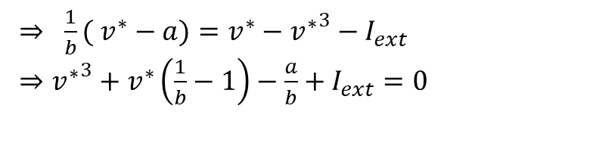
The Phase Plane – Equilibrium points
The equilibria are found at the crossing between the nullclines.
Find the roots of this equation
To find the equilibrium points, you have to solve: ${\left.\frac{dv(v,w)}{dt}\right|}_{{(v}^{∗},w^{∗})}=0⇒ w^{∗}=v^{∗}−{v^{∗}}^{3}−I_{ext}$
${\left.\frac{dw(v,w)}{dt}\right|}_{{(v}^{∗},w^{∗})}=0⇒ w^{∗}=\frac{1}{b}( v^{∗}−a)$
$⇒ \frac{1}{b}( v^{∗}−a)=v^{∗}−{v^{∗}}^{3}−I_{ext}$
$⇒{v^{∗}}^{3}+v^{∗}\left(\frac{1}{b}−1\right)−\frac{a}{b}+I_{ext}=0$

Slide 21
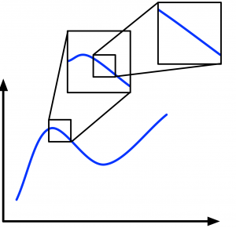
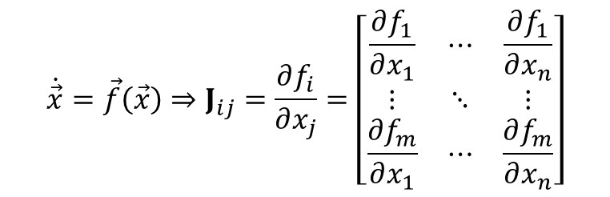
The Phase Plane –Nature of the equilibria
The local nature and stability of the equilibrium is given by linearizing the flow function. As we zoom in on a function it becomes more and more linear.
We can conceptually do the same for the equilibrium points in our phase planes. Even if the trajectories of the state variables in the phase planes are very curvy, if we zoom in enough on the equilibrium points, the trajectories at a point will eventually become effectively linear.
Mathematically, we apply linearization to an arbitrary model by first calculating what is called the Jacobian matrix of the model. The Jacobian is a linear approximation of our (potentially) non-linear model derivatives.
$$\dot{\vec{x}}=\vec{f}\left(\vec{x}\right)⇒J_{ij}=\frac{∂f_{i}}{∂x_{j}}=\left[\begin{matrix}\frac{∂f_{1}}{∂x_{1}} & ⋯ & \frac{∂f_{1}}{∂x_{n}} \\ ⋮ & ⋱ & ⋮ \\ \frac{∂f_{m}}{∂x_{1}} & ⋯ & \frac{∂f_{m}}{∂x_{n}}\end{matrix}\right]$$

Slide 22
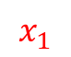
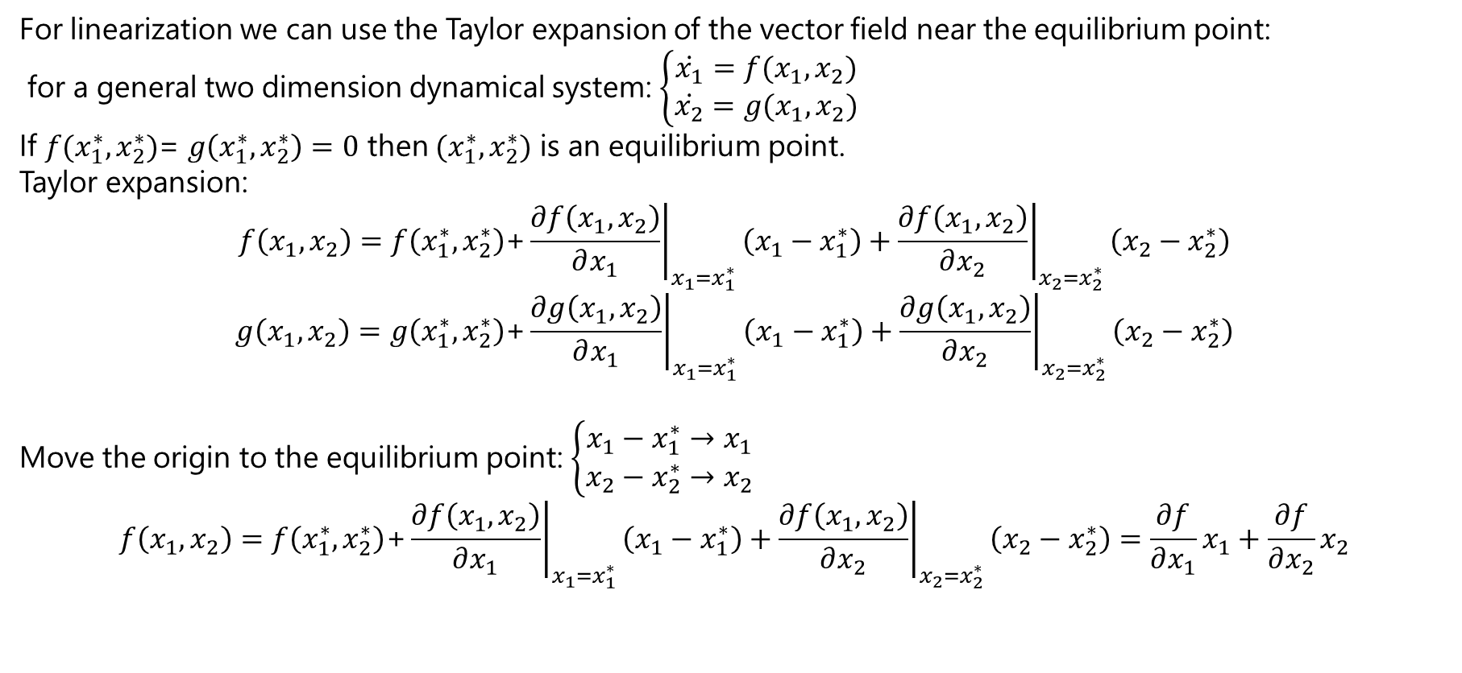

The Phase Plane – Equilibrium points - Nature of the equilibria
For linearization we can use the Taylor expansion of the vector field near the equilibrium point:
for a general two dimension dynamical system: $\left\{\begin{aligned}\dot{x_{1}}=f(x_{1},x_{2}) \\ \dot{x_{2}}=g(x_{1},x_{2})\end{aligned}\right.$
If $f(x_{1}^{∗},x_{2}^{∗})$= $g\left(x_{1}^{∗},x_{2}^{∗}\right)=0$ then $(x_{1}^{∗},x_{2}^{∗})$ is an equilibrium point.
Taylor expansion:
$$f\left(x_{1},x_{2}\right)=f\left(x_{1}^{∗},x_{2}^{∗}\right)\text{+}{\left.\frac{∂f\left(x_{1},x_{2}\right)}{∂x_{1}}\right|}_{x_{1}=x_{1}^{∗}}\left(x_{1}−x_{1}^{∗}\right)+{\left.\frac{∂f\left(x_{1},x_{2}\right)}{∂x_{2}}\right|}_{x_{2}=x_{2}^{∗}}\left(x_{2}−x_{2}^{∗}\right)$$
$$g\left(x_{1},x_{2}\right)=g\left(x_{1}^{∗},x_{2}^{∗}\right)\text{+}{\left.\frac{∂g\left(x_{1},x_{2}\right)}{∂x_{1}}\right|}_{x_{1}=x_{1}^{∗}}\left(x_{1}−x_{1}^{∗}\right)+{\left.\frac{∂g\left(x_{1},x_{2}\right)}{∂x_{2}}\right|}_{x_{2}=x_{2}^{∗}}\left(x_{2}−x_{2}^{∗}\right)$$
Move the origin to the equilibrium point: $\left\{\begin{aligned}x_{1}−x_{1}^{∗}→x_{1} \\ x_{2}−x_{2}^{∗}→x_{2}\end{aligned}\right.$
$$f\left(x_{1},x_{2}\right)=f\left(x_{1}^{∗},x_{2}^{∗}\right)\text{+}{\left.\frac{∂f\left(x_{1},x_{2}\right)}{∂x_{1}}\right|}_{x_{1}=x_{1}^{∗}}\left(x_{1}−x_{1}^{∗}\right)+{\left.\frac{∂f\left(x_{1},x_{2}\right)}{∂x_{2}}\right|}_{x_{2}=x_{2}^{∗}}\left(x_{2}−x_{2}^{∗}\right)=\frac{∂f}{∂x_{1}}x_{1}+\frac{∂f}{∂x_{2}}x_{2}$$
0
$$x_{1}$$
$$x_{2}$$

Slide 23


The Phase Plane – Equilibrium points - Nature of the equilibria
$$\left\{\begin{aligned}\frac{dx_{1}}{dt}=f\left(x_{1},x_{2}\right)=\frac{∂f}{∂x_{1}}x_{1}+\frac{∂f}{∂x_{2}}x_{2} \\ \frac{dx_{2}}{dt}=g\left(x_{1},x_{2}\right)=\frac{∂g}{∂x_{1}}x_{1}+\frac{∂g}{∂x_{2}}x_{2} \end{aligned}⇒\left({f(x_{1},x_{2}) \atop g(x_{1},x_{2})}\right)=\left({\dot{x_{1}} \atop \dot{x_{2}}}\right)=\left(\begin{matrix}\frac{∂f}{∂x_{1}} & \frac{∂f}{∂x_{2}} \\ \frac{∂g}{∂x_{1}} & \frac{∂g}{∂x_{2}}\end{matrix}\right)\left({x_{1} \atop x_{2}}\right)\right.$$
$$\frac{d\vec{x}}{dt}=\vec{\dot{x}}=J\vec{x}$$
The stability of typical equilibria of smooth ODEs is determined by the sign of real part of eigenvalues of the Jacobian matrix.
The equilibrium is said to be hyperbolic if all eigenvalues of the Jacobian matrix have non-zero real parts.
If at least one eigenvalue of the Jacobian matrix is zero or has a zero real part, then the equilibrium is said to be non-hyperbolic. Non-hyperbolic equilibria are not robust (i.e., the system is not structurally stable): Small perturbations can result in a local bifurcation of a non-hyperbolic equilibrium, i.e., it can change stability, disappear, or split into many equilibria.

Slide 24

The Phase Plane – Equilibrium points - Nature of the equilibria
A general two-dimensional system of linear differential equations can be written in the form:
$\left\{\begin{aligned}\frac{dx}{dt}=ax+by \\ \frac{dy}{dt}=cx+dy\end{aligned}\right.\underset{⇒}{matrix format} \frac{d}{dt}\left({x \atop y}\right)=\left(\begin{matrix}a & b \\ c & d\end{matrix}\right)\left({x \atop y}\right)⇒\frac{d\vec{x}}{dt}=A\vec{x}$
Solving using eigenvalues
$det\left( A−λI\right)=0⇒A\vec{x}=λ\vec{x}⇒λ_{1},λ_{2} are the eigenvalues and\left[\begin{matrix}k_{1} \\ k_{2}\end{matrix}\right],\left[\begin{matrix}k_{3} \\ k_{4}\end{matrix}\right] are the basic eigenvectors$
The general solution is: $x=\left[\begin{matrix}k_{1} \\ k_{2}\end{matrix}\right]c_{1}e^{λ_{1}t}$+$\left[\begin{matrix}k_{3} \\ k_{4}\end{matrix}\right]c_{2}e^{λ_{2}t}$
The above determinant leads to the characteristic polynomial:
$λ^{2}−\left(a+d\right)λ+\left(ad−bc\right)=0\underset{→}{τ\text{=}\text{a}\text{+}\text{d}\text{=}\text{tr}\text{(}\text{A}\text{);} Δ\text{=}\text{ad}\text{−}\text{bc}\text{=}\text{det}\text{(}\text{A}\text{)}}λ^{2}−τλ+Δ=0$
The explicit solution of the eigenvalues are then given by the quadratic formula:
$λ=\frac{1}{2}\left(τ±\sqrt{τ^{2}−4Δ}\right)$

Slide 25









Classification of Equilibrium points
$λ=\frac{1}{2}\left(p±\sqrt{Δ}\right) \underset{→}{Δ=p^{2}−4q} \left\{\begin{aligned}λ_{1}=λ_{1r}+iλ_{1i} \\ λ_{2}=λ_{2r}+iλ_{2i}\end{aligned}\right.$
$λ$ is pure real : $\left\{\begin{aligned}λ_{1},λ_{2}<0 :stable node \\ λ_{1},λ_{2}>0 :unstable node \\ λ_{1}<0<λ_{2}:saddle point\end{aligned}\right.$
$λ$ is complex : $\left\{\begin{aligned}λ_{r},λ_{i}≠0, λ_{r}<0 :stable focus \\ λ_{r},λ_{i}≠0, λ_{r}>0 :unstable focus \\ λ_{r}=0, λ_{i}≠0 :center\end{aligned}\right.$
https://www.math24.net/linear-autonomous-systems-equilibrium-points/

Slide 26

The Phase Plane – Equilibrium points - Nature of the equilibria
The signs of the eigenvalues will tell how the system's phase plane behaves:
If the signs are opposite, the intersection of the eigenvectors is a saddle point.
If the signs are both positive, the eigenvectors represent stable situations that the system diverges away from, and the intersection is an unstable node.
If the signs are both negative, the eigenvectors represent stable situations that the system converges towards, and the intersection is a stable node.
The above can be visualized by recalling the behavior of exponential terms in differential equation solutions.

Slide 27


The Phase Plane – Equilibrium points - Nature of the equilibria
Jacobian of the FHN model:
$\left\{\begin{aligned}\frac{dv}{dt}=v−v^{3}−w−I_{ext} \\ τ\frac{dw}{dt}=v−a−bw \end{aligned}\right.$
$\left[\begin{matrix}F_{1}(v+h,w+k) \\ F_{2}(v+h,w+k)\end{matrix}\right]=\left[\begin{matrix}F_{1}(v,w) \\ F_{2}(v,w)\end{matrix}\right]+\left[\begin{matrix}\frac{∂F_{1}(v,w)}{∂v} & \frac{∂F_{1}(v,w)}{∂w} \\ \frac{∂F_{2}(v,w)}{∂v} & \frac{∂F_{2}(v,w)}{∂w}\end{matrix}\right]\left[\begin{matrix}h \\ k\end{matrix}\right]+O\left(\left\|\left[\begin{aligned}h \\ k\end{aligned}\right]\right\|\right)$
$${\left.J\right|}_{v,w}=\left[\begin{matrix}\frac{∂F_{1}(v,w)}{∂v} & \frac{∂F_{1}(v,w)}{∂w} \\ \frac{∂F_{2}(v,w)}{∂v} & \frac{∂F_{2}(v,w)}{∂w}\end{matrix}\right]=−\left[\begin{matrix}1−3v^{2} & −1 \\ \frac{1}{τ} & \frac{−b}{τ}\end{matrix}\right]$$

Slide 28


The Phase Plane – Equilibrium points - Nature of the equilibria
To find the equilibrium points, you have to find the roots of this equation
${v^{∗}}^{3}+v^{∗}\left(\frac{1}{b}−1\right)−\frac{a}{b}+I_{ext}=0$

Slide 29

The Phase Plane- Fixed Points and Closed Orbits
Show a small perturbation of the stable equilibria

Slide 30

Types of Equilibria - One-Dimensional Space
Equilibria of a one-dimensional system x’′=f(x) are the points where f(x)=0.

Slide 31



Types of Equilibria - Two-Dimensional Space
$x′1=f1(x1,x2)$
$x^{′}2=f2\left(x1,x2\right)$
The Jacobian matrix has the form
$J=\left[\begin{matrix}\frac{∂f_{1}}{∂x_{1}} & \frac{∂f_{1}}{∂x_{2}} \\ \frac{∂f_{2}}{∂x_{1}} & \frac{∂f_{2}}{∂x_{2}}\end{matrix}\right]$
It has two eigenvalues, which are either both real or complex-conjugate. A hyperbolic equilibrium can be a:
Node both eigenvalues are real and of the same sign. The node is stable when the eigenvalues are negative and unstable when they are positive;
Saddle when eigenvalues are real and of opposite signs. The saddle is always unstable;
Focus (Spiral) when eigenvalues are complex-conjugate; The focus is stable when the eigenvalues have negative real part and unstable when they have positive real part.
$τ=tr(J)$
$Δ=det⁡(J)$

Slide 32

Types of Equilibria - Three-Dimensional Space
The Jacobian matrix of a three-dimensional system has 3 eigenvalues, one of which must be real and the other two can be either both real or complex-conjugate. Depending on the types and signs of the eigenvalues, there are a few interesting cases. A hyperbolic equilibrium can be:
Node when all eigenvalues are real and have the same sign; The node is stable (unstable) when the eigenvalues are negative (positive);
Saddle when all eigenvalues are real and at least one of them is positive and at least one is negative; Saddles are always unstable;
Focus-Node when it has one real eigenvalue and a pair of complex-conjugate eigenvalues, and all eigenvalues have real parts of the same sign; The equilibrium is stable (unstable) when the sign is negative (positive);
Saddle-Focus when it has one real eigenvalue with the sign opposite to the sign of the real part of a pair of complex-conjugate eigenvalues; This type of equilibrium is always unstable.
Notice that nodes and focus-nodes change stability when time is reversed, whereas saddles and saddle-foci are unstable regardless of the direction of time.

Slide 33

Types of Equilibria - Non-hyperbolic Equilibria
There are many more types of non-hyperbolic equilibria, i.e., those that have at least one eigenvalue with zero real part. Most of these equilibria do not have names or are named after the type of the bifurcation in which they play a role. Three examples are depicted in Figure.
The center equilibrium occurs when a system has only two eigenvalues on the imaginary axis, namely, one pair of pure-imaginary eigenvalues. If all other eigenvalues have negative real parts, centers are neutrally stable but not asymptotically stable.
The saddle-node equilibrium occurs in nonlinear systems with one zero eigenvalue when the system undergoes the saddle-node bifurcation, where a saddle and a node approach each other, coalesce into a single equilibrium (depicted in the figure), and then disappear. Saddle-nodes are always unstable.
The Bogdanov-Takens equilibrium occurs in nonlinear systems with 2 zero eigenvalues, typically when the system undergoes the Bogdanov-Takens bifurcation. It is also an unstable equilibrium.

Slide 34


The Phase Plane- Fixed Points and Closed Orbits
Two important types of trajectories are fixed points (sometimes called equilibria or rest points) and closed orbits.
1
Fixed points correspond to a constant solution:
at a fixed point $f\left(V_{R},n_{R}\right)=g\left(V_{R},n_{R}\right)=0$
2
Closed orbits correspond to periodic solutions:
if $(V\left(t\right),n(t))$ represents a closed orbit, then there exists $T > 0$ such that $\left(V\left(t\right),n\left(t\right)\right)=\left(V\left(t+T\right),n\left(t+T\right)\right)$ for all $t$.
Dynamical states of the system:
One dimension: fixed points
Two dimension: fixed points, limit cycles
Three and more dimension: fixed points, limit cycles, chaotic behavior

Slide 35

Bifurcation
Bifurcation theory is the mathematical study of changes in the qualitative or topological structure of a given family, such as the integral curves of a family of vector fields, and the solutions of a family of differential equations.
Bifurcation theory is concerned with how solutions change as parameters in a model are varied. For example, in the previous section we showed that the Fitzhugh-Nagumo equations may exhibit different types of solutions for different values of the applied current $I_{ext}$.
It is useful to divide bifurcations into two principal classes:
Local bifurcations, which can be analyzed entirely through changes in the local stability properties of equilibria, periodic orbits or other invariant sets as parameters cross through critical thresholds; and
Global bifurcations, which often occur when larger invariant sets of the system, such as periodic orbits, 'collide' with each other, or with equilibria of the system. They cannot be detected purely by a stability analysis of the equilibria (fixed points).

Slide 36
Local Bifurcation
A local bifurcation occurs when a parameter change causes the stability of an equilibrium (or fixed point) to change. The topological changes in the phase portrait of the system can be confined to arbitrarily small neighbourhoods of the bifurcating fixed points by moving the bifurcation parameter close to the bifurcation point (hence 'local').
Examples of local bifurcations include:
Saddle-node (fold) bifurcation
Transcritical bifurcation
Pitchfork bifurcation
Hopf bifurcation
Period-doubling (flip) bifurcation
Neimark–Sacker (secondary Hopf) bifurcation

Slide 37
Global Bifurcation
Global bifurcations occur when 'larger' invariant sets, such as periodic orbits, collide with equilibria. This causes changes in the topology of the trajectories in the phase space which cannot be confined to a small neighborhood, as is the case with local bifurcations. In fact, the changes in topology extend out to an arbitrarily large distance (hence 'global').
Examples of global bifurcations include:
Homoclinic bifurcation in which a limit cycle collides with a saddle point.
Heteroclinic bifurcation in which a limit cycle collides with two or more saddle points.
Infinite-period bifurcation in which a stable node and saddle point simultaneously occur on a limit cycle.
Blue sky catastrophe in which a limit cycle collides with a nonhyperbolic cycle.
Global bifurcations can also involve more complicated sets such as chaotic attractors (e.g. crises).

Slide 38



Local Bifurcation - Saddle-node bifurcation
two fixed points (or equilibria) of a dynamical system collide and annihilate each other or
A sudden creation of two fixed points.
If the phase space is one-dimensional, one of the equilibrium points is unstable (the saddle), while the other is stable (the node).
Saddle-node bifurcations may be associated with hysteresis loops and catastrophes.
1D: $\frac{dx}{dt}=r+x^{2}$

Slide 39


Local Bifurcation - Saddle-node bifurcation
2D: $\frac{dx}{dt}=β+x^{2}$
$\frac{dy}{dt}=−y$

Slide 40





Local Bifurcation -Transcritical bifurcation
An equilibrium having an eigenvalue whose real part passes through zero.
before and after the bifurcation, there is one unstable and one stable fixed point. However, their stability is exchanged when they collide.
$\frac{dx}{dt}=rx−x^{2}$
A typical example (in real life) could be the consumer-producer problem where the consumption is proportional to the (quantity of) resource:
$\frac{dx}{dt}=rx(1−x)−px$
$rx\left(1−x\right)$: is the logistic equation of resource growth
$px$: is the consumption, proportional to the resource $x$

Slide 41




Local Bifurcation – Pitchfork bifurcation
The system transitions from one fixed point to three fixed points.
Pitchfork bifurcations have two types, supercritical and subcritical.
Supercritical case $\frac{dx}{dt}=rx−x^{3}$
The potential of the system is defined by $f\left(x\right)=−\frac{dV}{dx}$
Then $\frac{dV}{dx}=rx−x^{3}⇒V\left(x\right)=−\frac{1}{2}rx^{2}+\frac{1}{4}x^{4}$

Slide 42


Local Bifurcation – Pitchfork bifurcation
The system transitions from one fixed point to three fixed points.
Pitchfork bifurcations have two types, supercritical and subcritical.
Subcritical case
The existence of different stable states allow for the possibility of jumps and hysteresis as $r$ is varied.

Slide 43



Local Bifurcation – Hopf bifurcation
The appearance or the disappearance of a periodic orbit through a local change in the stability properties of a steady point is known as the Hopf bifurcation.
Hopf bifurcations have two types, supercritical and subcritical. The limit cycle is orbitally stable if a specific quantity called the first Lyapunov coefficient is negative, and the bifurcation is supercritical. Otherwise it is unstable and the bifurcation is subcritical.
Hopf bifurcations occur in the Lotka–Volterra model, the Hodgkin–Huxley model, the Selkov model, the Belousov–Zhabotinsky reaction, the Lorenz attractor, and the Brusselator.
The Selkov model is
$\frac{dx}{dt}=−x+ay+x^{2}y$
$\frac{dy}{dt}=b−ay−x^{2}y$
Hodgkin–Huxley model
As the parameters change, a limit cycle (in blue) appears out of an unstable equilibrium.

Slide 44



Local Bifurcation – Hopf bifurcation
Supercritical Andronov-Hopf bifurcation in the plane.
Subcritical Andronov-Hopf bifurcation in the plane.
Supercritical Hopf bifurcation in the 3D-space.

Slide 45

Local Bifurcation – Period doubling – Period halving
A period-doubling bifurcation corresponds to the creation or destruction of a periodic orbit with double the period of the original orbit.
A period halving bifurcation in a dynamical system is a bifurcation in which the system switches to a new behavior with half the period of the original system.

Slide 46
Global Bifurcation
Global bifurcations occur when 'larger' invariant sets, such as periodic orbits, collide with equilibria. This causes changes in the topology of the trajectories in the phase space which cannot be confined to a small neighborhood, as is the case with local bifurcations. In fact, the changes in topology extend out to an arbitrarily large distance (hence 'global').
Examples of global bifurcations include:
Homoclinic bifurcation in which a limit cycle collides with a saddle point.
Heteroclinic bifurcation in which a limit cycle collides with two or more saddle points.
Infinite-period bifurcation in which a stable node and saddle point simultaneously occur on a limit cycle.
Blue sky catastrophe in which a limit cycle collides with a nonhyperbolic cycle.
Global bifurcations can also involve more complicated sets such as chaotic attractors (e.g. crises).

Slide 47

Global Bifurcation – Homoclinic bifurcation
occurs when a periodic orbit collides with a saddle point.
Left panel: For small parameter values, there is a saddle point at the origin and a limit cycle in the first quadrant. Middle panel: As the bifurcation parameter increases, the limit cycle grows until it exactly intersects the saddle point, yielding an orbit of infinite duration. Right panel: When the bifurcation parameter increases further, the limit cycle disappears completely.

Slide 48

Global Bifurcation – Heteroclinic bifurcation
a limit cycle collides with two or more saddle points.
1
all trajectories spiral into (0, 0)
2
the Hopf and saddle-node bifurcations occur simultaneously at r = 1.02
3
trajectories originating close to zero spiral out to a limit cycle, while trajectories originating sufficiently far from zero terminate on one of the stable steady states (solid dots) possibly after being deflected by one of the saddle points (hollow dots)
4
the limit cycle has been destroyed by colliding with the saddle points in a heteroclinic bifurcation and all trajectories terminate on one of the stable steady states.
Tuckerman, L.S., 2001. Thermosolutal and binary fluid convection as a 2× 2 matrix problem. Physica D: Nonlinear Phenomena

Slide 49

Global Bifurcation – Infinite-period bifurcation
when two fixed points emerge on a limit cycle. As the limit of a parameter approaches a certain critical value, the speed of the oscillation slows down and the period approaches infinity. The infinite-period bifurcation occurs at this critical value. Beyond the critical value, the two fixed points emerge continuously from each other on the limit cycle to disrupt the oscillation and form two saddle points.

Slide 50

Global Bifurcation – Blue-sky catastrophe
In blue-sky catastrophe a periodic orbit of large period appears "out of a blue sky" (actually, the orbit is homoclinic to a saddle-node periodic orbit). The blue sky catastrophe has turned out to be a typical phenomenon in slow-fast systems
(a) There are two equilibria: one stable (denoted O1) and another saddle-stable (denoted O2). The system tends from O2 to O1 as time continues (transitionary phase).
(c) If the timescale difference increases further and passes a particular threshold, both cycles coalesce into a single cycle with infinite length and period. This situation forms the blue sky state Lbs.
(b) Changes in the timescale difference ϵ of the underlying system variables lead equilibrium O1 to lose stability and become the stable limit cycle L1. Further changes in ϵ force O2 to lose stability also and to become an unstable limit cycle L2. Once both O1 and O2 become limit cycles, the system transits slowly from L2 to L1 as time continues
N. Gavrilov, A. Shilnikov, Example of a blue sky catastrophe, ibid, 99-105, 2000.

Slide 51
Bifurcations Involving Periodic Orbits
A bifurcation is a qualitative change in the behavior of a dynamical system as a system parameter is varied. This could involve a change in the stability properties of a periodic orbit, and/or the creation or destruction of one or more periodic orbits. Bifurcation analysis can thus provide another (analytical or numerical) method for establishing the existence or non-existence of a periodic orbit:
Andronov-Hopf bifurcation, which results in the appearance of a small-amplitude periodic orbit;
Saddle-node bifurcation of periodic orbits, in which two periodic orbits coalesce and annihilate each other;
Saddle-node on invariant circle bifurcation (SNIC), in which a periodic orbit appears from a homoclinic orbit to a saddle-node equilibrium (along the central manifold);
Homoclinic bifurcations, in which periodic orbits appear from homoclinic orbits to a saddle, saddle-focus, or focus-focus equilibrium.
Period doubling bifurcation (also known flip bifurcation), in which a periodic orbit of period 2T appears near a periodic orbit of period T .
Neimark-Sacker bifurcation, in which an invariant torus appears near a periodic orbit.
Blue-Sky Catastrophe, in which a periodic orbit of large period appears "out of a blue sky" (actually, the orbit is homoclinic to a saddle-node periodic orbit).

Slide 52


Slide 53

Bifurcations of FHN model
the bifurcation diagram for v with respect to parameter $I_{ext}$
There are four bifurcations of codim 1 in this diagram: two fold bifurcation (saddle-node) and two Hopf bifurcations (stable focus-unstable focus).

Slide 54

Bifurcations of FHN model

Slide 55


Bifurcations of FHN model
bifurcation diagram for v with respect to parameters I and b

Slide 56


Non autonomous system
So far we have considered the behavior of the system under a constant stimulus $I_{ext}$. However, it is possible to extend this model to cases where the stimulus is more complex, by making $I_{ext}$ a function of time.
$\left\{\begin{aligned}\frac{dv}{dt}=v−v^{3}−w−I_{ext}(t) \\ τ\frac{dw}{dt}=v−a−bw \end{aligned}\right.$

Slide 57

Non autonomous system- Periodic stimulus

Slide 58

Stochastic Differential Equation
So far we have seen continuous-time, continuous-state determinsitic systems in the form of Ordinary Differential Equations (ODE). Their stochastic counterpart are Stochastic Differential Equations (SDE).
Consider the now familiar non-autonomous ODE:
$$\frac{dx}{dt}=f(x,t)$$
The corresponding integral equation is:
$$x\left(t\right)=x\left(0\right)+\int_{0}^{t}{f\left(x\left(s\right),s\right)ds}$$
The SDE would be
$$dX_{t}=f\left(X_{t},t\right)dt+g\left(X_{t},t\right)dW_{t}$$
$W_{t}$ stands for the Wienner Process. The corresponding integral equation is:
$$x\left(t\right)=x\left(0\right)+\int_{0}^{t}{f\left(X_{s},s\right)ds}+\int_{0}^{t}{g\left(X_{s},s\right)dW_{t}}$$
We have to use stochastic methods, such as Euler-Maruyama method, or stochastic Runge-Kutta method.

Slide 59

FHN model + noise

Slide 60

FHN model phase plane + noise

Slide 61
Thank you for your attention!
You can find python codes needed to produce most of the plots here:
https://github.com/SaeedTaghavi/dynamical_systems_neuroscience
Notes:
In Slide Show mode, select the arrows to visit links.

